Slide 1
Challenge Orientation
Bertelsmann Technology Scholarship
November 21, 2019

Slide 2

Program Overview
Getting Started
Accessing your Classroom
Slack Community
Community Resources
Upcoming Initiatives
Scholarship Advice from Ioannis
Final Wrap Up
Live Q&A
Happy Hour!
TODAY’S
AGENDA

Slide 3
Program
Overview

Slide 4




There are 2 Scholarship Phases:
Challenge Phase
15 week Challenge Course ending March 5, 2020
Robust Community Experience
Support from Student Leaders
Dedicated Community Manager
Nanodegree Phase
1,600 students to receive a full Scholarship to either Deep Learning, Data Analyst or Cloud DevOps Nanodegree.
Challenge Phase:
15,000 Students
1,600 Students
Data Analyst Nanodegree
Cloud DevOps Nanodegree
Deep Learning Nanodegree

Slide 5

Successful completion of the Challenge course
Course progress should be 100% in order for you to be selected.
Level of participation and support of classmates in the student community
All the selection criteria used in Phase 1
Criteria that was used when you were selected for Phase 1
Selection Criteria for Phase 2

Slide 6
Getting
Started

Slide 7
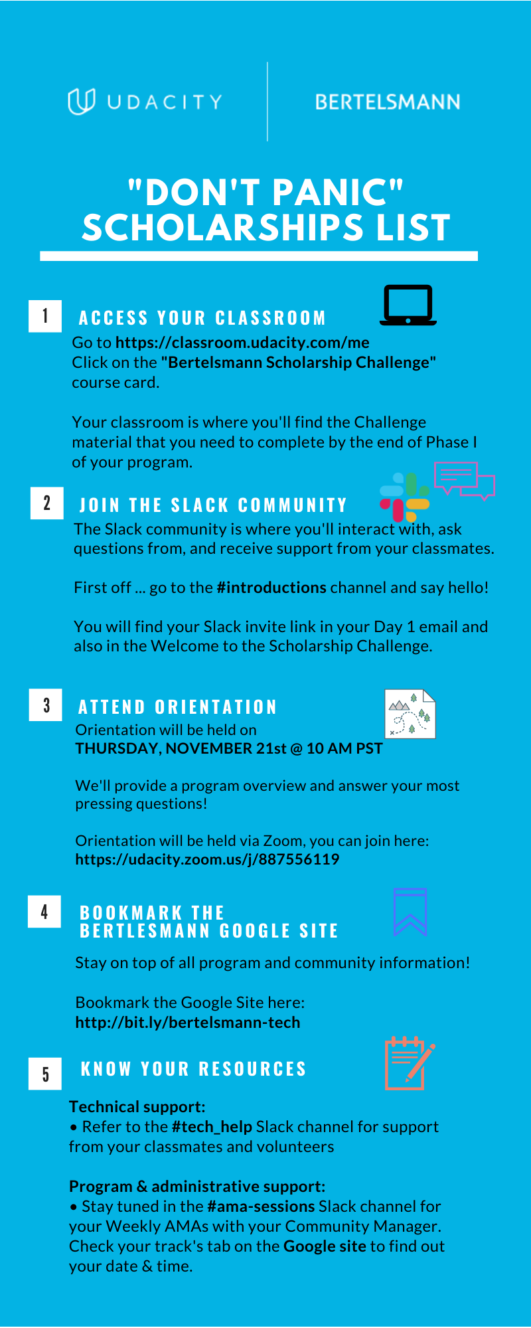
D
O
N’
T
P
A
N
I
C
L
I
S
T
5 Easy Steps to Getting Started
Access Your Classroom
Join the Slack Community
Attend Orientation
Bookmark the Bertelsmann Challenge Google Site
Know Your Resources
Print the “Don’t Panic” sheet here.

Slide 8
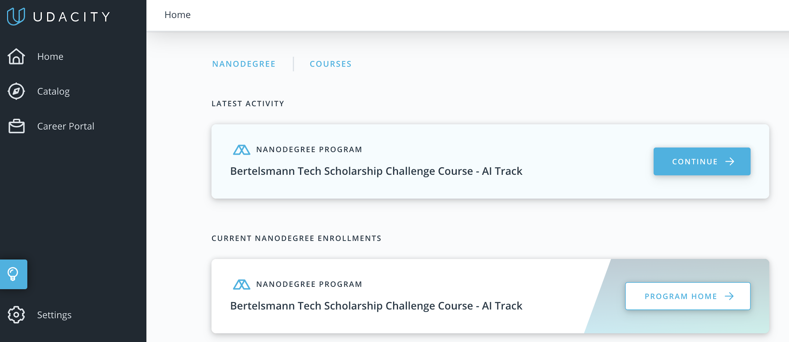
Accessing your Classroom
Go to your classroom using this link: https://classroom.udacity.com/me and find the Bertelsmann Tech Scholarship Challenge course card

Slide 9
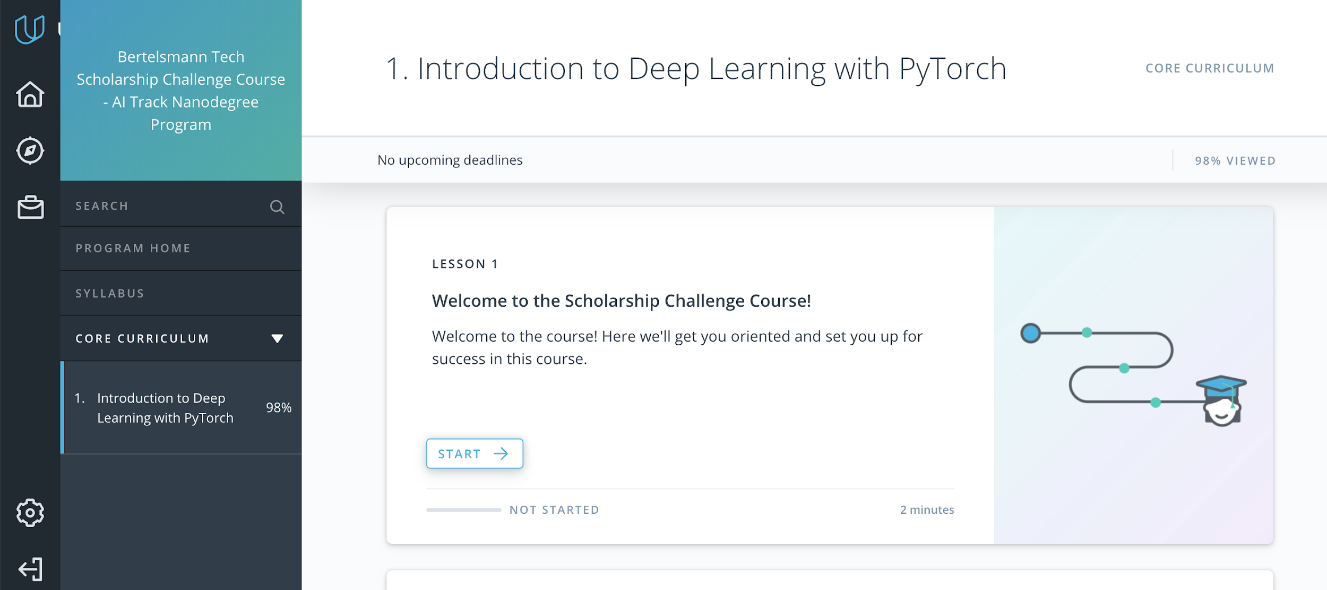
After clicking your course card, click “Core Curriculum” to reach your coursework and begin your journey with the first lesson.

Slide 10
Slack
Community

Slide 11

Join the Slack Community
Find the invite link in your welcome email and the Welcome Lesson in your classroom
Meet and connect with classmates!
Get technical help from peers and Student Moderators
Receive support & motivation
Participate in AMA (Ask Me Anything) sessions and other community events!
New to Slack? Use our How to Use Slack here.

Slide 12

& Community Guidelines
ONE: Respond in thread! We want to keep the whole convo together! Make sure to respond IN THREAD to the person you are replying too.
TWO: Use the Right Channel. Before you post, make sure you are posting your question or content in the correct channel
THREE: Be respectful of differing viewpoints and experiences. This is a space for learning and we want everyone to feel comfortable and welcome.
FOUR: Gracefully accept constructive criticism. We are here to grow and help one another! If someone has feedback about a project or idea, listen.
FIVE: What is best for the overall community. Make decisions that will impact the community positively! Find our Code of Conduct here

Slide 13

Study for an hour everyday
Stay active on the Slack Community & help your peers
Keep an eye out for messages on #announcements channel
Show up for official sessions like #ama_sessions
Follow the channels that you think are important for you Don’t track every channel
Take part in the Community Initiatives
Find a Study Partner or Study Group!
How to be a successful student?

Slide 14
Community
Resources

Slide 15
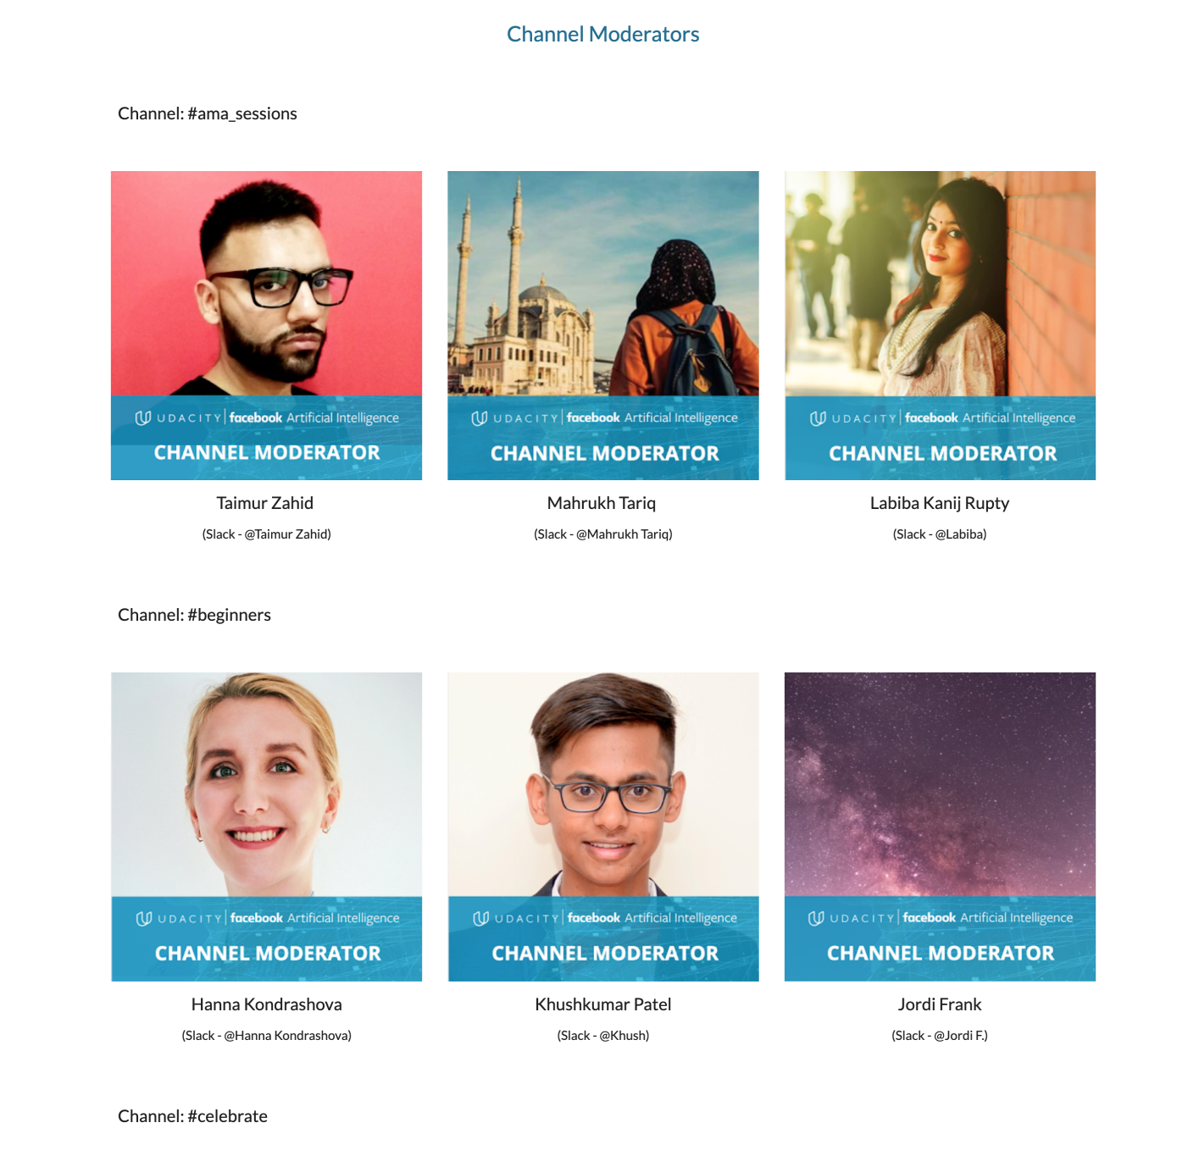
Channel
Leaders
Take help from your peers who have stepped up and decided to be Channel Leaders.
Every channel will have at least 3 Channel Leaders that you can reach out in case you need help
You can identify them using this Unique Frame in their profile picture.

Slide 16
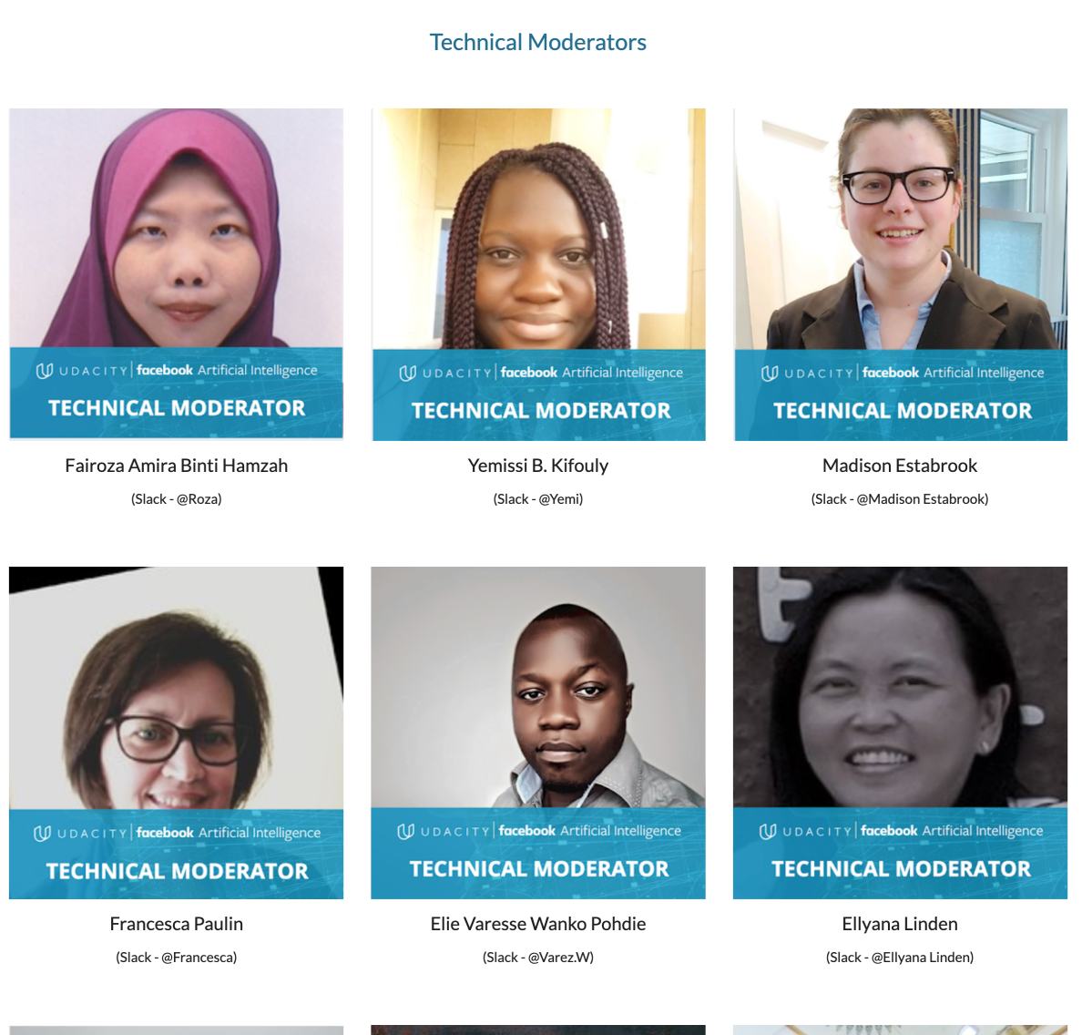
Technical Leaders
Classmates who may be Udacity graduates or have technical backgrounds, Use them for technical knowledge & guidance!
They will be available in the Slack #tech_help channel during designated times.
Applications for both roles open Monday, November 25! 👍

Slide 17
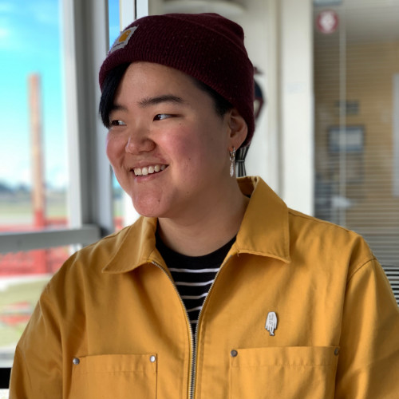

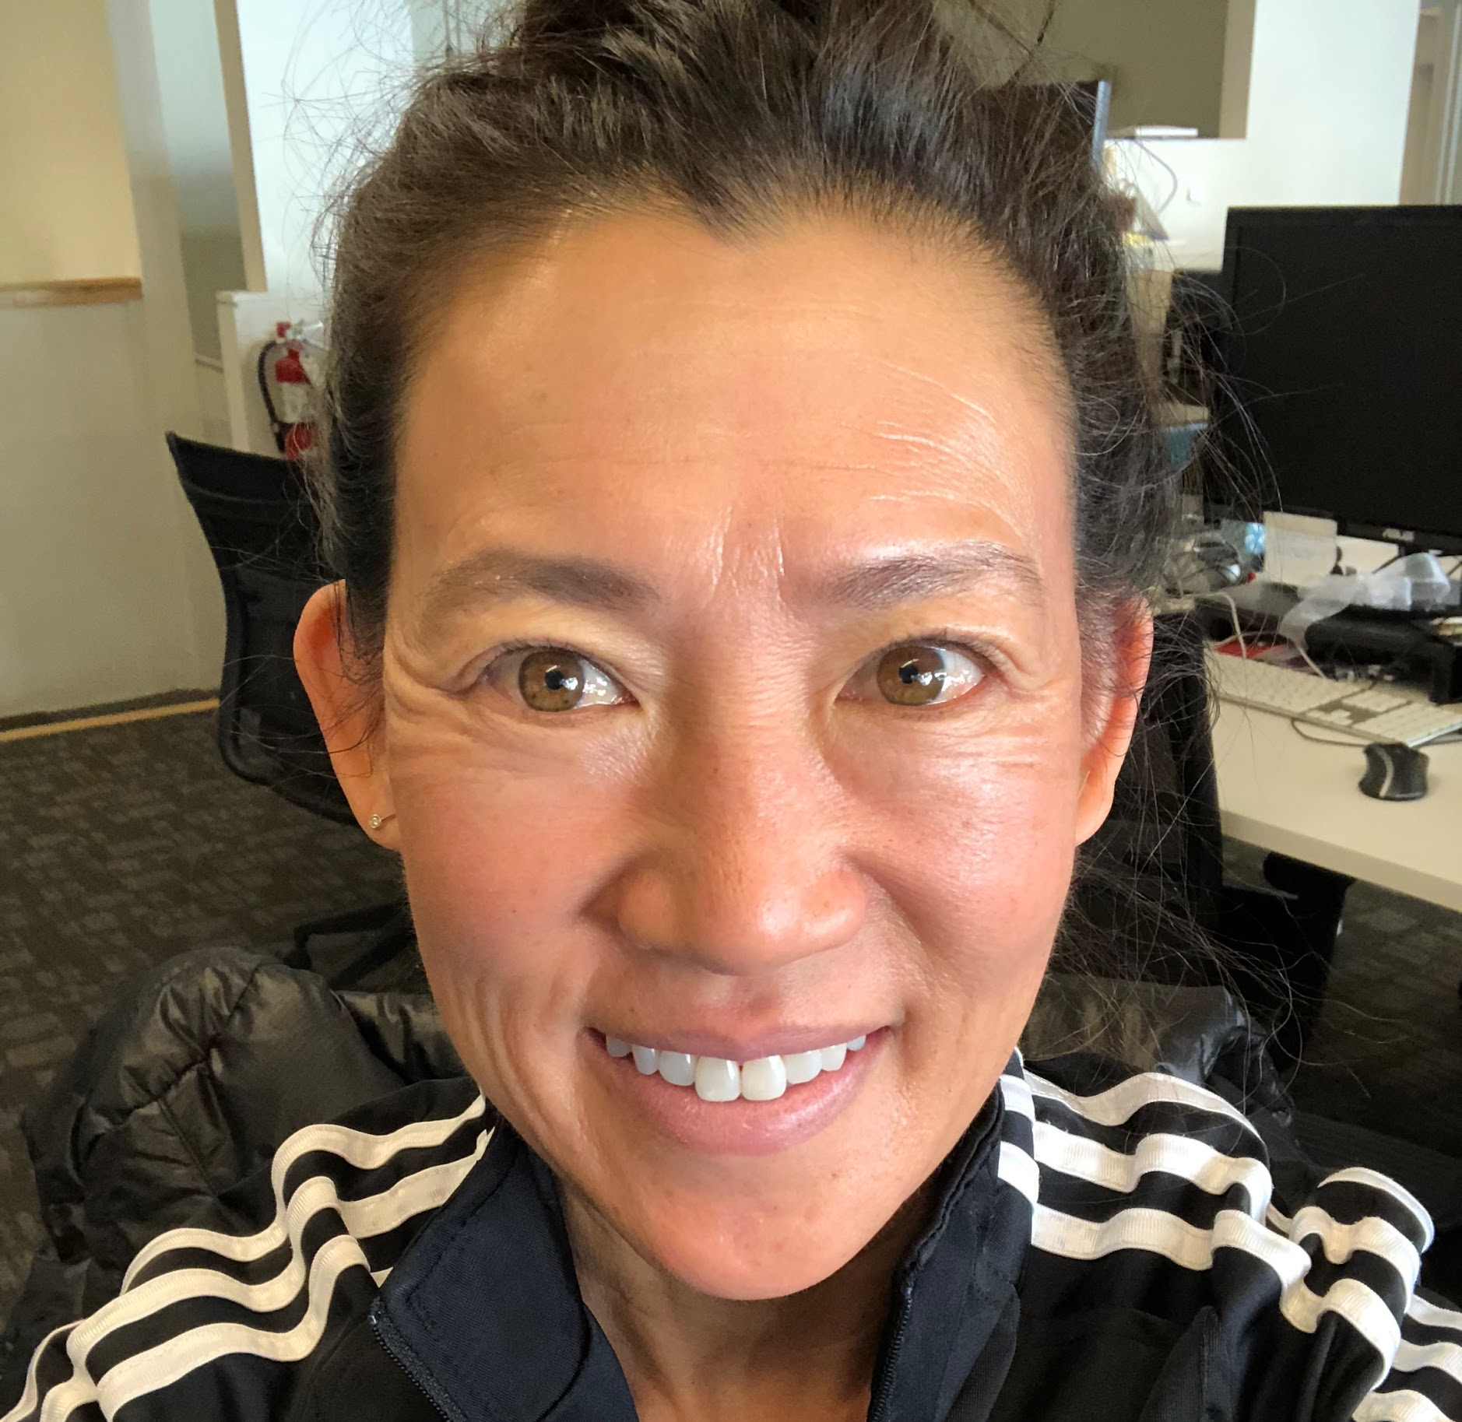
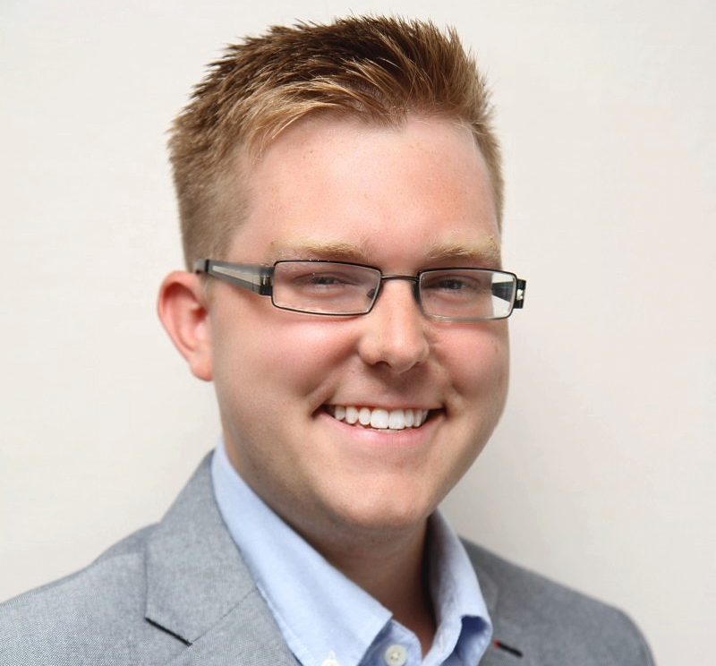
Scholarships Team
AMA Sessions for program and administrative questions in the #ama-session channel in Slack. Check your Track on the Google site for date & time.
Email Support for account questions. please use our Submit a request with Scholarships in the dropdown
DM (Direct Message) with questions that are urgent or concern a personal matter
Grace Cho
AI Track
@Grace.Udacity
Palak Sadani
Data Track
@Palak.Udacity
Brenda Law
Cloud Track
@Brenda.Udacity
Clayton Wert
Cloud Track
@Clayton.Udacity

Slide 18

Bookmark the Bertelsmann Challenge Google Site
The Bertelsmann Challenge site is your go-to spot for information on announcements, resources, the calendar of events, FAQ’s, and more! Anytime you have a question, come here first to see if it’s already been answered.
Link: http://bit.ly/bertelsmann-tech

Slide 19
Upcoming
Initiatives

Slide 20
Community Initiatives
Study Groups
BINGO!
Study Jam
Join a Study Group that matches your interests or location. It’s a great way to learn with peers
Coming 11/25/19
A Study Group can be for anything - meetups, lessons, concepts etc. and you can join which ever you want
Play Bertelsmann BINGO - our fun, interactive game to ease you into the Community & Course material!
Coming 11/22/19
Cover all spots on your Bingo card and submit it for a chance at a Udacity swag!
An truly collaborative experience when all students come together to work on their coursework
Coming Soon!
Volunteers needed for live technical & moral support & to host instructional webinars

Slide 21
Scholarship Advice

Slide 22
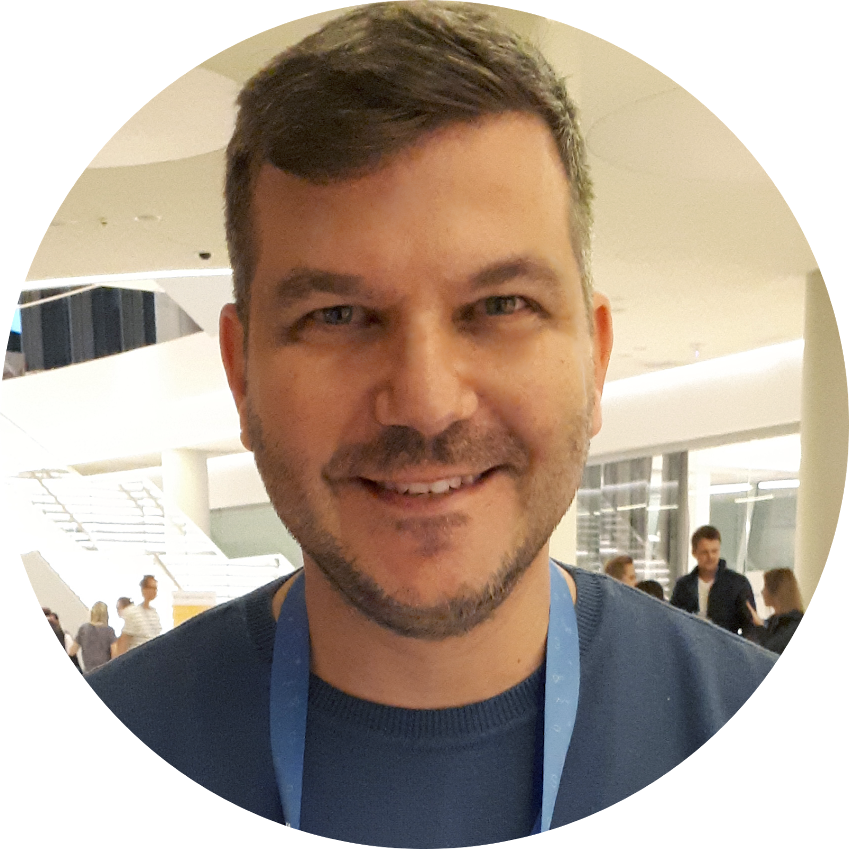
Meet Ioannis Anifantakis!
A little about Ioannis…
Holds a BSc & MSc in Computer Science.
Completed the Deep Learning, Deep Reinforcement Learning for Enterprise, and Android Developer Nanodegrees.
Scholarships: Google & Facebook PyTorch
Working as software engineer for 15+ years, a programming instructor since 2014 and as a speaker at technology events since 2016.
© 2019 Udacity. All rights reserved.

Slide 23






Surviving the Challenge…
Material
Community
Initiatives

Slide 24

Material
Stick on a weekly schedule - Be consistent
Keep Notes, they boost your learning
Cover all Videos & Quizzes
Revisit the material even if you understand it
Seek help but don’t plagiarise

Slide 25


Community
Your participation to the community matters!
“hello posts” don’t count as activity. Don’t flood!
Don’t hesitate to ask - answer questions
Other students are not your competitors
Join the weekly slack sessions (AMAs)
Racism, Sexism, Bias of any kind will not be tolerated. We are all equal.

Slide 26
Initiatives
Form or Join a Study Group at slack
Make weekly Slack & Video sessions to help and be helped
The best way to learn is to explain the subject to other students who need help!

Slide 27

So what counts?
Survival Wrap up...
#1 Completion of Material & Quizzes… before the challenge deadline
#2 Slack participation with…
posts relevant to the challenge subject
Don’t leave all that for the last day…

Slide 28

Wrapping up…
When does the Challenge phase end?
The deadline for completing your Challenge course is March 5th, 2020
Do I need to complete all the coursework?
Yes. You will need to complete the coursework by March 5th, 2020 to be considered for Phase 2.
Do I have to participate in Phase 1?
Yes, participation is required in Phase 1 as it is one of the selection criteria for Phase 2. While your #1 priority should be progressing through and completing your coursework. We recommend you engage with your peers, since we have seen time and again that the most successful students are those who learn in community. Best of luck!
© 2019 Udacity. All rights reserved.

Slide 29
Live Q&A

Slide 30
Q&A…
Happy Hour!*
Join us in the #introductions channel in Slack to meet your new classmates, answer fun ice-breaker questions, and relax a little!
*No alcohol required!!!

